Slide 1
Delivering Hands-On Integrated STEM Education in the Elementary Classroom
Michael Daugherty, & Pre-service Teacher Education Candidates, University of Arkansas

Slide 2
Why must STEM be delivered in the elementary school?
The ultimate goal of the STEM movement is to increase students’ interest and ability in STEM.
Engage students early—they’re naturally interested
But that interest fades substantially by 4th grade
Too many high school students opting out of STEM
Limiting their future and our economy
Prepare students with basic STEM skills for an uncertain future
Prepare innovators, inventors, quality team members
And… ultimately enhancing our competitive position
Early intervention (in the elementary school) is crucial

Slide 3
STEM Augments the Curriculum
Elementary STEM education is NOT simply the addition of curriculum to hectic schedules.
integrate into pre-existing lessons as PBL learning enhancements
Excellent way to creatively meet state and national standards in the classroom
Non-threatening way to increase student engagement in math and science

Slide 4
INTEGRATED STEM
Authentic, engaging, hands-on learning
Developing thinking skills
How to think vs. what to think
Problem/Project-based learning
Curiosity, imagination, technological literacy
Exploiting technology to foster creativity
Treating effective teamwork as an outcome
Learning transfer: Basic skills—application—synthesis
Building a STEM mental warehouse!

Slide 5
Curriculum Models & Standards
Understanding by Design
Curriculum filters
Problem/project based learning
Discipline based heuristics & engineering design
Standards and frameworks
Collaborative learning format
Lesson & unit plan model
Performance-based assessment

Slide 6
What is PROJECT-BASED LEARNING (PBL)?
Investigation/resolution of messy, real-world problems.
Learning in relevant and connected ways.
Exposure to higher order thinking.
Facilitating deeper application and understandings.
Addressing problems that engage students
Building on previous learning

Slide 7
What is PROJECT-BASED LEARNING (PBL)?
Using ill-structured problems to increase personal responsibility for learning
Engaging students in STEM at an early age.
Causing students to gather information, assess its validity/provide evidence to support decisions.
Encouraging learning transfer
Emphasizing the importance of teamwork
Emphasizing knowledge transfer

Slide 8
How disciplinary content is delivered in STEM?

Slide 9
Start with Standards
Common Core Standards (ELA & Math)
Next Generation Science Standards
Technology for All Americans Standards
Look for Connections
Solve problems that arise in one discipline and then cross-over
Look for connections (i.e., apply math in contexts outside of math)
Make sense of problems/persevere in solving
Analyze givens, constraints, relationships, etc.

Slide 10
Standards-based Curriculum Development
Start w/big idea or Engaging topic to be taught
Review standards/look for connections
Determine how you will measure achievement
What must students know & be able to do
Consider resources (i.e., informational texts)
Consider PBL approaches for delivery
Consider material resources and tools
Plan the lesson/activity/challenge
Assess the students (i.e., performance-based)
Determine additional instruction (rinse/repeat)

Slide 11
THE DESIGN CHALLENGE
Kinds of problems
Exploring a question, Investigating a historical event, Problem solving situation, Examining controversial issue, Designing an artifact, Create a piece of writing, art, or multimedia
Where to start?
Standards/frameworks, Your community (recycling, community history, pets), Items relevant to students (cars, toys, etc.), What people do outside school (farmers, construction workers, engineers, dentists), Colleagues, and On-line resources

Slide 12
Ultimate Goal
We need to prepare a generation of students who can “out innovate” the competition, who can adapt to vast advances in technology and engineering, who can apply known solutions to unknown applications , who readily cross disciplinary lines to gather the tools necessary to solve the problems of humanity.

Slide 13
THE NARRATIVE CURRICULUM
Narrative-Centered Learning Environments
Use children’s literature to promote STEM
Expand upon a book commonly shared in schools
Move from comfortable to uncomfortable/known to unknown
Story-centric problem solving activities
Compelling virtual worlds
Believable characters
Thought provoking themes

Slide 14
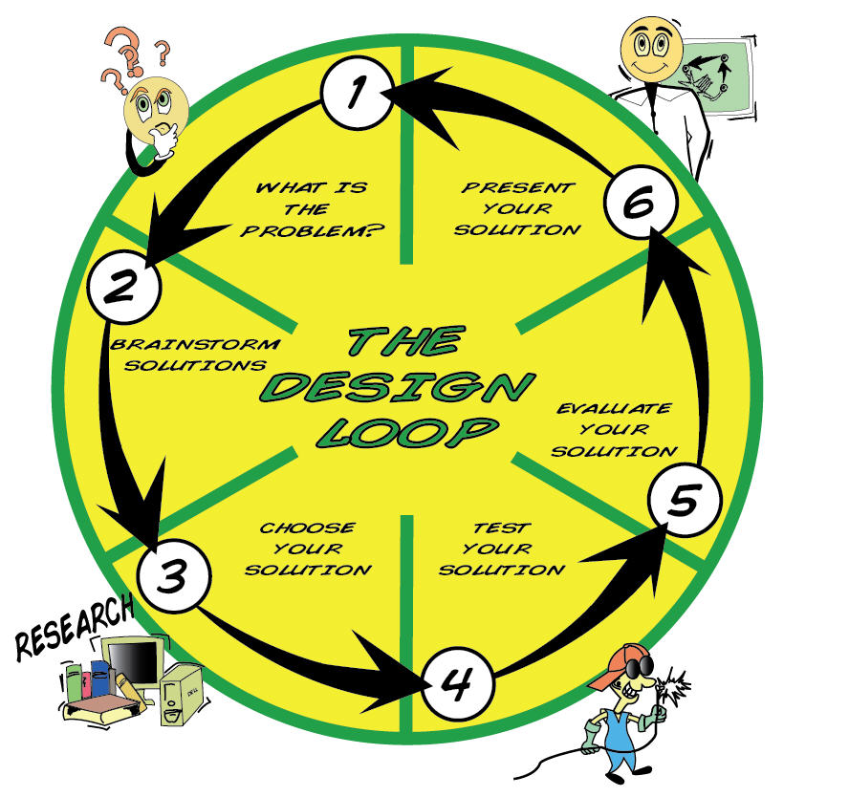
Cognitive Tools (scientific inquiry & the engineering design process)

Slide 15
Example Projects
STEM assessment
Flash cards
Mobile design
Engineering portfolio
Resource procurement
Electronics project
Pop-up book activities
Narrative curriculum
Programmable control project
KEVA planks
Creating/solving long-term design challenges:
Human-power challenge
Earthquake proof shelter
Solar vehicle
Robotics

Slide 16
Paddle Boat Race: Design paddle boat to move fastest in water
Big Ideas:
Proper use of the design loop
Recycled materials and their ability to move across the water
Understand kinetic energy and the improvement of water transportation
Ability to validate and present final model to the class

Slide 17
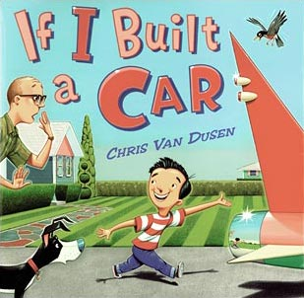
Car builder: Design a passenger vehicle
Big Ideas:
Using the Engineering design process
brainstorming & problem solving
creative thinking for innovation
Understanding how to measure
motion, force, and energy
Understanding the value of money

Slide 18
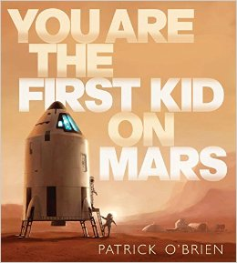
Mars Ascension Vehicle: Design a Mars launcher
Big Ideas:
Properties of the Eng. Design
Understanding transfer of energy
converting measurements (inches – feet - miles)
create devices that meet given requirements
Conservation of fuel (natural resources)

Slide 19
http://stem.uark.edu/
STEM RESOURCES

